Slide 1

CMS Update 2019
Bill H. McCully CHFM SASHE
Senior Consultant
MSL Healthcare Partners

Slide 2
Codes and Standards Changes
NFPA 101: Life Safety Code ®: 2000 to 2012
NFPA 99: Health Care Facilities Code®: 1999 to 2012
CMS Conditions of Participation for Emergency Management

Slide 3
Codes and Standards Update
CMS Water Management Requirement - June 2, 2017
CMS additional K-Tags to accommodate new codes
TJC Reshuffling of the EPs
Notes:
Must have a water management plan for your hospital.

Slide 4
Codes and Standards Update
Over 51% of all hospitals surveyed last year were condition level at the end of the survey.
EC. 02 06.01 EP 1 was the most cited with environmental safety and ligature issues.
Notes:
Condition level means a follow up survey by TJC
About one half were environmtal – Blocked elect panels, Unsecure cylinders, Ext. Cord tripping, Stained ceiling, call cords

Slide 5
Codes and Standards Update
2018 Hospital adverse decisions and immediate threat to Health
Year PDA ITL
2016 35 9
2017 54 34
2018 88 29
Year #Deemed Hospitals % Hospitals w/CLD
2016 1142 34.2%
2017 1190 52.0%
2018 1186 50.0%

Slide 6
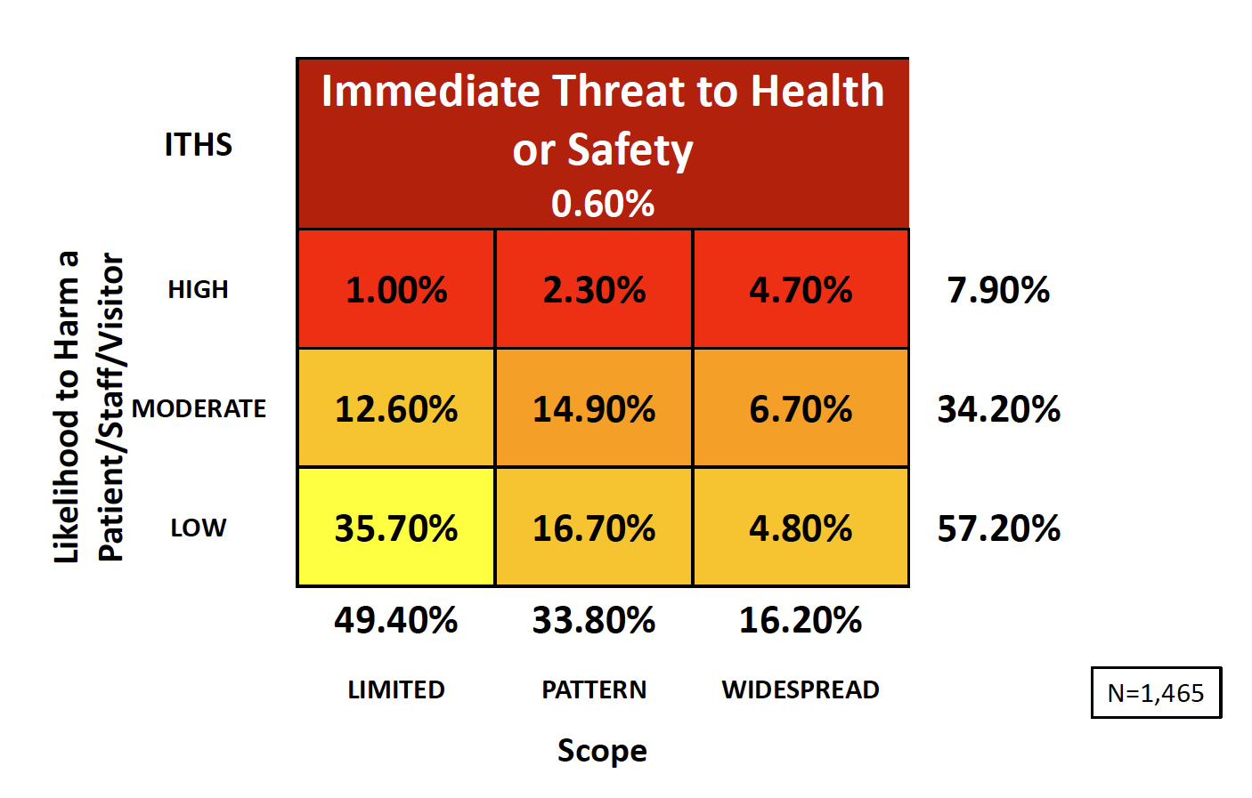
Codes and Standards Update
2018 Results
Notes:
High category up from 4.70, moderate down from 37.41 and low stable from 57.67 ITL is up from 0.22%

Slide 7
Codes and Standards Update
Notes:
EC 02.06.01 Ligature: 54% in the bathroom, door, hinge, handle, etc.
EC.20.05.01 Pressure relationships, RPT’s, Labeling utilities, etc.
EC.02.05.09 Cylinder handling, discrepancy follow up, door signage,
EC.02.03.03 Fire drill timing, 3rd shift bells silent, follow up on critique issues.

Slide 8
Codes and Standards Update
Notes:
4 of the 10 listed are ILSM related.

Slide 9
Codes and Standards Update
Ligature Risk EC.02.06.01
“Without points where a cord, rope, bedsheet,
or other fabric/material can be looped or tied to create a sustainable point of attachment that may result in self-harm or loss of life.”

Slide 10
Codes and Standards Update
Must be ligature resistant:
Inpatient psychiatric units, in both psychiatric and general/acute care
hospitals
Dedicated spaces in the emergency department

Slide 11
Codes and Standards Update
Not required to be ligature resistant:
• But are required to have conducted an environmental risk assessment and have steps, protocols, safeguards, etc. in place to protect suicidal patients:
— Emergency departments
— General medical/surgical inpatient units
— Residential, partial hospitalization, and day treatment programs — Intensive outpatient programs

Slide 12
Codes and Standards Update
Where are ligature risks scored?
Element of Performance for EC.02.06.01
EP1. Interior spaces meet the needs of the patient population and are safe and suitable to the care, treatment, and services provided.
The Most cited EP in the standards and scored in the High Harm category of the safer matrix.

Slide 13
Codes and Standards Update
Eye Wash Stations:
Often misunderstood, eyewash stations are required in health care facilities where staff members handle caustic or corrosive chemicals.

Slide 14
Codes and Standards Update
What is Caustic or Corrosive?
Corrosive chemicals commonly used
in health care, such as glutaraldehyde (used to sterilize surgical equipment) and formaldehyde, and for caustic chemicals used in facility cleaning and boiler maintenance, including bleach and sodium hydroxide (caustic soda), the applicable SDS recommends flushing eyes with a stream of water for several (often 15 to 20) minutes.
Notes:
Many hospitals struggle with this standard.

Slide 15
Codes and Standards Update
Eye Wash Stations:
“Where the eyes or body of any person may be exposed to injurious corrosive materials, suitable facilities for quick drenching or flushing of the eyes and body shall be provided within the work area for immediate emergency use.” It must be within 10 seconds or 55 feet and not behind locked doors.
Notes:
Most misunderstood standard Corrosive chemical only

Slide 16
Codes and Standards Update
Eye Wash Stations:
Most often cited:
Inaccessible, poorly maintained, missing inspections.
Record temperature at least quarterly to prove temp stays between 60 and 100 degrees per the ANSI standard.

Slide 17
Codes and Standards Update
Fire Drills: most commonly cited issues:
Holding drills at unexpected times ( when scheduling drills at least one hour separation is required to ensure unexpected times).
Silent 3rd shift drills (only the bells may be silenced, all other devices must operate).

Slide 18
Codes and Standards Update
Incomplete critiques:
Critiques must document what happened during the drill including staff reactions, equipment functionality or failures.
Staff responsibilities:
Any rolling equipment must be accounted for in the drill. Test staff to ensure they know how to move the equipment and where it goes during an emergency.

Slide 19
Codes and Standards Update

Slide 20
Codes and Standards Update
Water Management :
Write a water management Plan
Majority of hospitals testing for Legionella, not required to test but risk assess if not testing.
Perform a building survey to identify at risk systems
Conduct environmental risk assessment
Include in the emergency operations plan and the utilities management plan; emergency response and immediate steps if there were to be confirmed cases of legionella in the facility

Slide 21
Codes and Standards Update
Time Definitions for The Joint Commission
Weekly – any time during the week generally Sunday through Saturday.
Monthly – 30 day intervals = 12 times per year or once per calendar month.
Quarterly – every 3 months plus or minus 10 days.
Semi annual – every 6 months from the last event plus or minus 20 days.
Annually – every 12 months = 1 year from last event plus or minus 30 days.

Slide 22
Codes and Standards Update
Time Definitions for The Joint Commission
3 years or 36 months = 36 months from the last event plus or minus 45 days

Slide 23
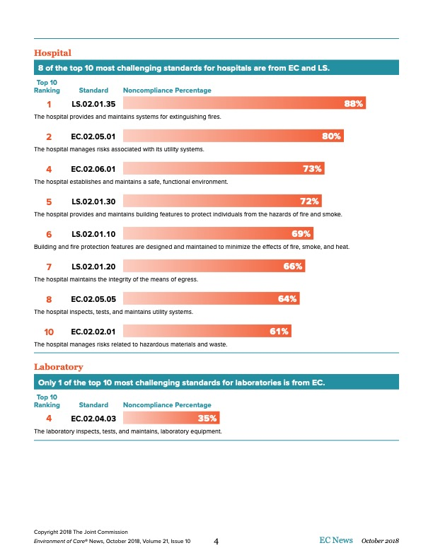
Codes and Standards Update

Slide 24
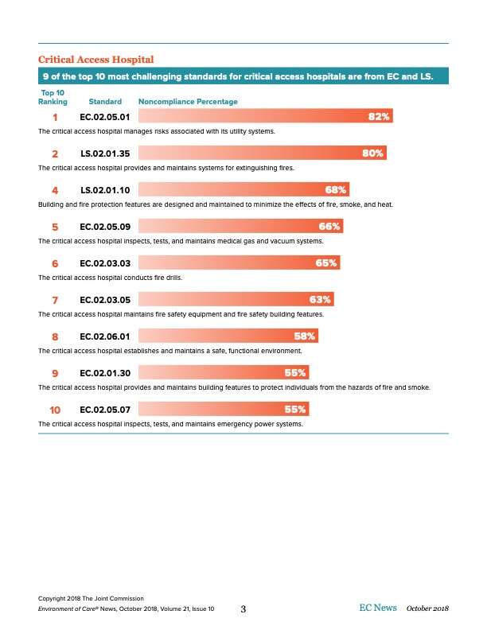
Codes and Standards Update

Slide 25
Codes and Standards Update

Slide 26
Codes and Standards Update

Slide 27
Codes and Standards Update
Emergency Generators: EC.02.05.07
EP 4 Weekly Inspection Includes ATS
EP 5 Testing Monthly under load
EP 6 Testing annually ramping for 1.5 hrs.
EP 7 Transfer each switch monthly
EP 8 Annual fuel testing
EP 9 Triennial 4 hour test run.
Notes:
EP 4 Include 110 code and OEM recommendations also check from ambient at least 40 degrees.

Slide 28
Codes and Standards Update
Stairwell exit enclosures:
TJC says no equipment is allowed in the exit enclosure including evac chairs/sleds. Security cameras, card readers, WI-FI routers allowed if not interfering with evacuation.
Egress Obstruction:
2012 LSC improved the egress rules slightly. Some wheeled carts such as patient lifts, isolation and crash carts are allowed but staff must be able to speak to where those carts go in an emergency.

Slide 29
Codes and Standards Update
Questions???

Slide 30
Codes and Standards Update
Emergency Preparedness
Expect a more in depth survey regarding emergency management than in past surveys.
EM Committee Representatives:
IT representative, to address Cyber security such as, risk awareness, incident detection, incident response, and a cyber security exercise is recommended.
Medical Staff, Preferably from ED
Senior Leadership
Other departments as determined

Slide 31
Codes and Standards Update
1135 Waiver:
Under certain declared disasters or public health emergencies,
waivers may be granted to ensure specific healthcare items and service are available. Examples include HIPAA, EMTALA, pre-approvals, etc.
For further information see: https://www.cms.gov/Medicare/Provider-Enrollment-and- Certification/SurveyCertEmergPrep/1135-Waivers.html
Must have policies and procedures in place
Organizations must know how to contact the government if a waiver is required.
Name, address and contact information for the regional CMS office.

Slide 32
Codes and Standards Update
Emergency Planning continued:
The required communications plan can be included in the EOP. A separate plan is not necessary, but the COP requirements must be met.
The Joint Commission training requirements are more stringent than those of CMS, and will remain.
An additional section on Integrated Healthcare Systems will be added to the Joint Commission EM requirements. EC.04.01.01
The requirement for annual review of the EOP s\and HVA will remain the same.
The requirement for annual review of the emergency resources inventory.

Slide 33
Codes and Standards Update
Emergency Planning continued:
Two emergency exercises annually should include:
Patient Influx
Sustainability
Community wide participation
HVA scenarios
The emergency exercises can include actual emergencies if the HICS is activated and documented properly

Slide 34
Codes and Standards Update
Emergency Planning continued:
Continuity of Operations and Leadership Succession Plans will be required.
Continuity of Operations: strategies to continue critical and time sensitive processes, as identified in a business impact analysis
Business Impact Analysis: analysis that identifies impacts or disruption of an entities resources, and may include time-critical functions, recovery priorities, dependences etc.

Slide 35
Codes and Standards Update
Emergency Planning continued:
Behavioral Health: managing mental health patients in an emergency requires extra effort as they are a different population.
There must be a plan as to how they are moved or evacuated and where they would go if needed.
This plan should be drilled
Evacuation of hospital should be drilled.

Slide 36
Codes and Standards Update
CMS “Burden Reduction” Proposals Pending:
The periodic review of the EOP might switch to every two years instead of the current one year.
Documentation of Efforts to Cooperate with Emergency Preparedness Officials
For the annual exercise the provider may choose between a second full-scale exercise or a tabletop exercise, CMS proposes to expand the exercise options to a second full-scale exercise, a tabletop exercise, or a mock disaster drill.

Slide 37
Codes and Standards Update
Common Pitfalls:
IC.02.01.01 EP 1 - Ice Machines – Regular PM to include sanitize inside and out. If the tray and chute do not look clean , they will cite.
EC.02.05.01 EP 8 – Panel Labeling
Fire Alarm circuit marked
Outlets should be tamper-resistant in all areas where children are reasonably anticipated to be present

Slide 38
Codes and Standards Update
Common Pitfalls:
EC.02.05.05 EP 1: When performing repairs or maintenance the hospital has a process to manage risks associated with air quality; infection control; utilities; noise, odor, dust, vibration; and other hazards that affect patients, staff, and visitors.
EC.02.06.05 EP 2: “When planning for demolition, construction, renovation, or general maintenance, the hospital conducts a preconstruction risk assessment for air quality requirements; infection control; utility requirements; noise, odor, dust vibration; and other hazards that affect care, treatment, or services.”

Slide 39
Codes and Standards Update
Common Pitfalls:
Notify fire department and institute fire watch:
-Fire Alarms out for 4 or more hours in 24 hours
-Sprinklers out for 10 or more hours in 24 hours
New EP 15: “Other”
Any identified LS deficiencies during survey will require immediate assessment for ILSM. This would include devices found to be faulty when testing the system. Fire Alarm, Generators, Medical Gas, etc.
Have ILSM assessment forms available during the survey to do immediate assessment on any findings.

Slide 40
Codes and Standards Update
Common Pitfalls:
Exit sign inspection:
New last year
Monthly Inspection
Pass/fail result for each device
Inventory

Slide 41
Codes and Standards Update
Safety Management:
EC.01.01.01 EP 3
Library of manuals:
  Service Instructions
  Manufacturer maintenance procedures
  Specifications
  Instructions for use

Slide 42
Codes and Standards Update
Safety Management:
EC.02.01.03 EP 2:
Smoking materials removed from respiratory therapy patients
No sources of ignition within 1 foot of nasal cannula or in room for other delivery equipment

Slide 43
Codes and Standards Update
Fire Safety Management:
EC.02.03.05 EP 25: (Clarification note added)
Note 1: “Non-rated doors, including corridor doors to patient care rooms and smoke barrier doors, are not subject to the annual inspection and testing requirements of either NFPA 80 or NFPA 105. However, non-rated doors should be routinely inspected and maintained in proper working order.”
See also CMS SC 17-38 dated 7/28/17

Slide 44
Codes and Standards Update
Fire Safety Management:
EC.02.03.05 EP 27: Firefighter’s emergency operation tests of elevators.
REMEMBER THIS IS A MONTHLY TEST!!

Slide 45
Codes and Standards Update
MEDICAL EQUIPMENT:
EP 8: Labeling equipment in oxygen enriched atmospheres
EP 10: All occupancies with hyperbaric facilities comply with NFPA 99 (2012) chapter 14
EP 26: Anesthesia equipment maintenance

Slide 46
Codes and Standards Update
UTILITY SYSTEMS RISK:
EP 1: Design of utility systems per NFPA codes
EP 2: Building system NFPA 99 risk assessments
EP 20: ORs wet procedure locations unless otherwise risk assessed
EP 21: Electrical distribution system NFPA 99 risk assessment

Slide 47
Codes and Standards Update
UTILITY SYSTEMS RISK:
EP 22: Electrical receptacle types, testing, & cover plates
EP 23: Power strips in patient care vicinity
EP 24: Extension cord restrictions
EP 25: General anesthesia medical gas zone valves, alarm panels, alarm sensors
EP 26: General anesthesia locations use essential electrical system, critical branch

Slide 48
Codes and Standards Update
EMERGENCY POWER SOURCE &
UTILITY INSPECTION, TESTING MAINTENANCE:
EC.02.05.03:EP 11:
EPS has remote manual stop with identifying label
EP 14: Medical dispensing equipment on emergency power
EP 15: Emergency power for essential medication refrigerators and freezers
EP 16: Battery lamps & flashlights in areas without emergency power
EC.02.05.05:
EP 7: Line isolation monitor testing

Slide 49
Codes and Standards Update
EC.02.05.07 – EMERGENCY POWER SYSTEMS:
EP 1: 30 second monthly test of battery operated egress lighting, task lighting, & exit signs
  All other exit signs visually inspected
EP 2: Annual 90 minute test of battery operated egress lighting & exit signs
  Anesthesia locations 30 minute annual test

Slide 50
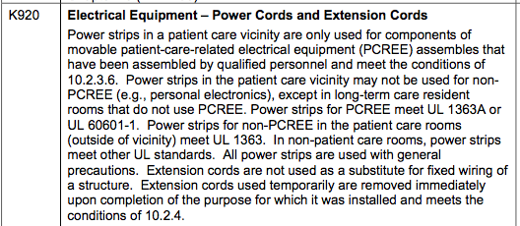
Codes and Standards Update

Slide 51
Codes and Standards Update
EC.02.05.09 – MEDICAL GAS & VACUUM SYSTEMS:
EP 1: Medical gas, medical air, surgical vacuum, and WAGD NFPA 99 risk assessment
EP 2: Medical gas master, area, & local alarms comply with NFPA 99 category 1-3 warning systems
EP 3: Medical gas cylinder & container marking
EP 4: Labeling of doors in gas storage locations
EP 5: Labeling of doors in gas storage rooms
EP 6: Gas storage location by volume

Slide 52
Codes and Standards Update
EC.02.05.09 – MEDICAL GAS & VACUUM SYSTEMS:
EP 11: Medical gas valves and piping labeled & accessible
EP 12: Gas cylinder requirements & storage temperatures
EP 13: Trans-filling gas cylinders

Slide 53
Codes and Standards Update
EC.03.01.01 – STAFF ROLES AND RESPONSIBILITIES:
EP 1: Staff competency for maintenance, inspection, testing of medical equipment, utilities, fire safety systems, & handling hazmat
  Continuing education & training should be included in the text of every management plan with a brief statement of how it is accomplished

Slide 54
Codes and Standards Update
LS.02.01.10 – FIRE PROTECTION FEATURES:
EP 3 & 4: Changes in occupancy type or building addition complies with NFPA 101 chapter 43
EP 5: Rehabilitation of non-sprinkled smoke compartments
EP 8: Multiple occupancy building classification & separation

Slide 55
Codes and Standards Update
MEANS OF EGRESS BUILDING FEATURES (FIRE & SMOKE):
LS.02.01.20: EP 3 & 4: Horizontal sliding doors EP 11: Capacity of means of egress EP 17: Corridor access to exits EP 20 & 21: Existing & new exit access doors EP 37: Travel distance to exit in room or suite
LS.02.01.30: EP 4: Labs with severe hazards (per AHJ)

Slide 56
Codes and Standards Update
LS.02.01.34 – FIRE ALARM SYSTEMS:
EP 1: Fire alarm warning in all parts of building
EP 3: Fire alarm initiation & manual alarms
EP 4 & 5: Fire alarm audible & visual signals
EP 6: Fire alarm activation with emergency power
EP 8: Smoke detection in spaces open to corridor

Slide 57
Codes and Standards Update
LS.02.01.50 – MAINTAINS BUILDING SERVICES:
EP 1: Equipment using gas or gas piping; electrical equipment & wiring
EP 2: HVAC installed per manufacturer
EP 3: Alternative heating devices
EP 4: Suspended unit heaters
EP 6: Solid fuel burning fireplaces
EP 8: Escalators, dumbwaiters, moving walks

Slide 58
Codes and Standards Update
Immediate Jeopardy or ITL (Immediate Threat to Life)
Immediate jeopardy is a situation in which a recipient of care has suffered or is likely to suffer serious injury, harm, impairment or death as a result of a provider’s, supplier’s, or laboratory’s noncompliance with one or more health and safety requirements. Immediate jeopardy represents the most severe and egregious threat to the health and safety of recipients, as well as carries the most serious sanctions for providers, suppliers, and/or laboratories.

Slide 59
Codes and Standards Update
Questions???
Bill H. McCully CHFM SASHE
MSL Healthcare Partners
bmccully@mslhealthcare.com

