Slide 1
Alternative Procurement Methods

Slide 2








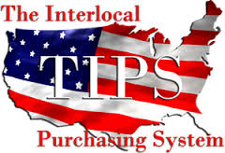


Introductions
HVAC
Fire
Security
Andrew Pergande
Johnson Controls Director of Customer Enablement
(414) 524-6937
Andrew.Pergande@JCI.com

Slide 3

Agenda
Alternative Procurement
Methods Discussion Topics
Introductions & Overview
Procurement Trends
Cooperative Contract Overview
Benefits of Cooperative Procurement
Cooperative Contract Award Process
Open Discussion and Q&A
Procuring the right products and services at right price

Slide 4
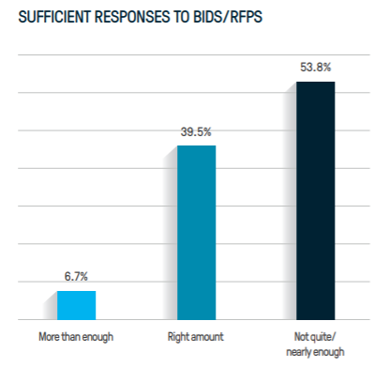
Trends in Public Procurement Professionals
More than half of respondents indicate that they are failing to attract enough interest among vendors and contractors to their competitive solicitations…
Spending relating to single-buyer, competitive bids & RFPs is decreasing as agencies focus on more efficient procurement methods…
Data Source: Survey-of-Government-Procurement-Professionals-2018-GovWin-Deltek
http://images.more.deltek.com/Web/DeltekInc/%7B99f494a0-c09d-4fb4-8b97-e1da9a5fe78f%7D_Survey-of-Government-Procurement-Professionals-2018-GovWin-Deltek.pdf

Slide 5
Cooperative Contract Usage is on the Rise
The study states, “Increased use of cooperative contracting is saving the time to conduct research, issue bid documents, and perform a lengthy evaluation process”
% of Total Contract Spend Using Cooperatives
81% of public procurement professionals utilized a cooperative contract in the last year
0%
1-9%
10-19%
20-49%
50-74%
75%+
Data Source: Onvia Survey-of-Government-Procurement-Professionals-2017

Slide 6








Todays Objectives
Cooperative Purchasing Contracts Overview
$
Provide an introduction to the benefits & value of using cooperative procurement
Understand how cooperatives agreements meet competitive procurement requirements
Discuss strategies to introduce alternative procurement methods

Slide 7
Cooperative Procurement Benefits
Cooperative Member
  Reduced procurement hurdles / contract has already been bid – Not having to go to bid again can save time and reduce cost within the procurement process
  National scale bid provides pricing member may not be able to achieve on their own
  Pricing transparency
  Avoids potential for low bid, low quality contracts
  Select the vendor they want to buy from & the rep they want to work with
  Confidence in the quality and delivery of supplier products and services
  Membership is free and registration is simplistic
Suppliers
  Reduces time and effort spent on bid activity
  Reduces sales cycle due to consistent and efficient procurement processes
  Stronger customer satisfaction due to focus on both value and quality vs. simply providing the cheapest solution that meets the specifications
  Shared savings model - reduced sales costs allow deeper pricing discounts

Slide 8








Who Can Become a Member and Procure through State Cooperative Contracts?
State and Local Government Entities
  Cities
  Counties
  States and State Agencies
  Special & Water Districts
  Native American Tribes
  Port & Transportation Authorities
Public and Private Education
  K-12
  Special Education Districts
  Charter Schools
  Higher Education/Universities
Non Profits (tax exempt organizations)
  Hospitals & Nursing Homes
  Rural Power Cooperatives
  Housing Authorities
  Member Associations & Coops

Slide 9
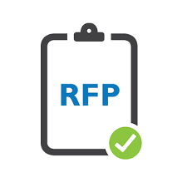


The Cooperative Contract Award Process
Cooperative Develops Request for Proposal
Public Notice & Advertisement
RFP Opening
RFP Evaluation
Benefits:
Studies membership needs
Conducts industry research
Benefits:
Advertise RFP notice
Host pre-proposal discussions
Benefits:
Official public RFP opening process for properly submitted proposals
Benefits:
Review proposals and evaluate on standardized scoring criteria
Expertise in RFP evaluations across many supplier categories
Contract awarded to most qualified suppliers based on rigorous RFP process and thorough evaluation

Slide 10
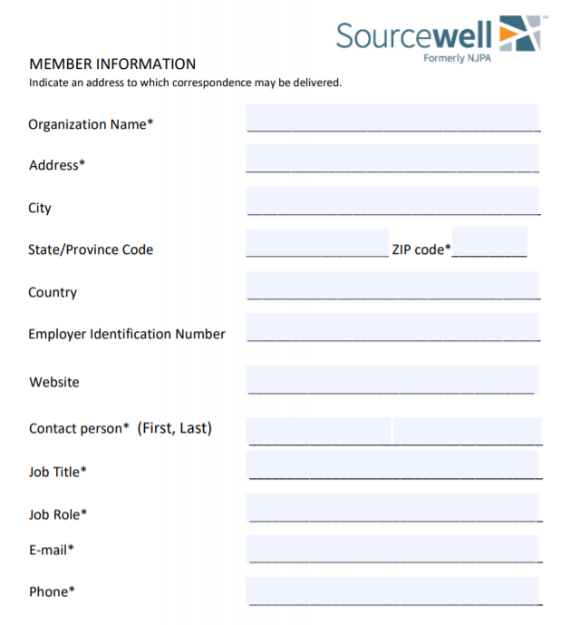



Cooperative Membership
https://youtu.be/yrZJLXmqkeA

Slide 11

Questions & Answers

