Slide 1
2019 ASHE Update
February 14, 2019

Slide 2
Rick McGuffey
Region 10 Director
ASHE

Slide 3
The American Society for Health Care Engineering (ASHE)
With 12,500+ members, ASHE is the largest professional membership group of the American Hospital Association (AHA).
ashe.org
Notes:
The American Hospital Association is the national organization that represents and serves all types of hospitals, health care networks, and their patients and communities. The AHA vision is of a society of healthy communities, where all individuals reach their highest potential for health.
ASHE is a personal membership group of the American Hospital Association. ASHE’s mission is to optimize the health care physical environment. Not only is ASHE the largest personal membership group of the American Hospital Association, with over 12,500 members, it is also the largest association dedicated to the health care physical environment.

Slide 4
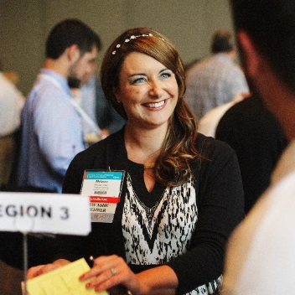
ASHE Mission, Vision, and Values
Mission:
Dedicated to optimizing the health care physical environment
Vision:
To engage stakeholders in the creation of health care environments that are optimal for healing.
Values:
Integrity, Innovation, Fellowship, and Stewardship
Notes:
ASHE MISSION
Dedicated to optimizing the health care physical environment.
ASHE VISION
To engage stakeholders in the creation of health care environments that are optimal for healing.
ASHE PURPOSE
To advance our members’ ability to design, build, operate, and maintain a physical environment that supports excellent care; quality service; safe, efficient, and effective operations; and financial success.
ASHE CORE VALUES
ASHE is committed to demonstrating these core values as we strive to achieve the goals set forth in our strategic plan:
Integrity—Demonstrated by uncompromised dedication to being a trusted, unbiased, and honest source of fact-based information and expertise.
Innovation—Demonstrated by continuing commitment to achieving the best of what is possible and serving as a trusted and respected source of evolving knowledge and practices.
Fellowship—Demonstrated by professional and personal pride in being part of a community of excellence with a common passion for good thinking, shared experience, and collective action.
Stewardship—Demonstrated by our profession’s acceptance of responsibility for success of the built environment and our leadership’s accountability for effective use of our members’ involvement in ASHE.

Slide 5
How can ASHE help me in my career?

Slide 6
Codes and Standards Resources
Latest CMS Conditions of Participation changes
Resources:
Tools
Monographs and publications
Education programs
Get answers:
My ASHE online community
Just Ask ASHE webinars (live and archived)
Notes:
The codes and standards regulating health care facilities are always changing. The CMS Conditions of Participation, for example, were changed in 2017 to reflect the 2012 editions of the Life Safety Code and the Health Care Facilities Code. CMS also approved its own emergency preparedness rule instead of adopting NFPA 99 emergency preparedness requirements.
It’s important to understand the complex codes regulating health care facilities , but it’s also important to understand where to get trusted information to stay on top of ever-changing regulations. ASHE offers several resources to help. All of the direct website addresses for these resources are included on the handout.
Our ASHE CMS Conditions of Participation webpage outlines information about complying with the latest CMS regulations. On the CMS Conditions of Participation webpage, ASHE members can access resources and tools, including a handy Conditions of Participation/Accreditation Crosswalk. ASHE members also have access to a variety of compliance tools. There’s a K-Tag crosswalk and risk assessment tools, as well as Environment of Care and Life Safety checklists that can help with compliance. Monographs and publications are a way to access more in-depth information on health care codes and standards.
ASHE also offers ways to get answers to specific code questions that come up during the course of the year. The My ASHE online community is a great resource. You can post your question and other ASHE members can share their thoughts and provide advice.
Just Ask ASHE quarterly webinars are another great information source. We have code experts participate in these quarterly webinars. Members can submit questions and it’s simply an hour of compliance Q&A. We archive these webinars also, so that you can go back and listen if you miss a call.

Slide 7
ASHE’s Health Facilities Management
Streamlined communications
Additional CEUs for members (10 issues per year vs. 4 issues!)
Greater awareness of ASHE members-only resources
Notes:
ASHE acquired Health Facilities Management Magazine in 2018 to create a singular, robust publication for health care facility management, planning, design, construction, and environmental services professionals.

Slide 8
ASHE Education Programs
LEARN
ENGAGE
GROW
Education tailored for various audiences:
Facility managers
Engineering professionals
Architects and planners
Project managers
Contractors
Compliance managers
And more
ashe.org/education
Notes:
Many programs appropriate to all ASHE audiences.
Education formats:
Face-to-face seminars and workshops
E-Learning/Distance learning
Hosted programs
Conferences
Webinars and On Demand Recordings

Slide 9
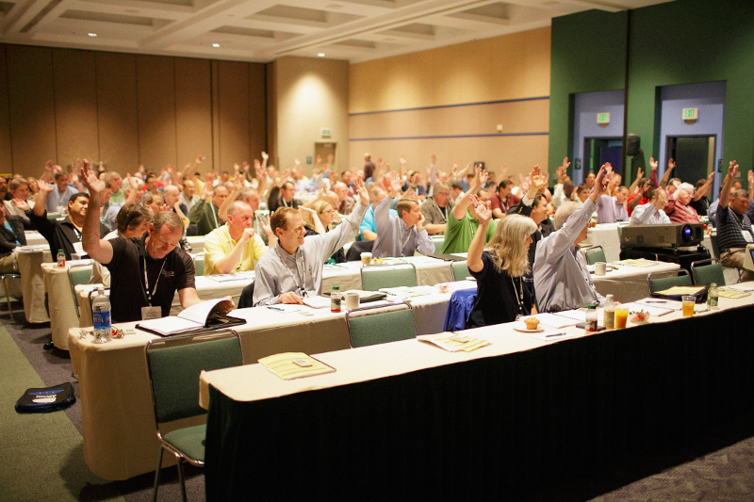
NEW Education Programs Released in 2018
Medical Gas Cylinder Storage e-Learning Course | ashe.org/medgas
Door Inspection and Maintenance Workshop | ashe.org/doors
Ventilation of Health Care Facilities: Complying with ASHRAE Standard 170 | ashe.org/ventilation
Physical Environment Survey Readiness Program | ashe.org/surveyready

Slide 10
Certification Information
Certified Health Care Constructor
Certified Health Care Facility Manager
Certified Health Care Physical Environment Worker
Exam review courses
Resource lists online
Learn more at ashe.org/certifications

Slide 11
New ASHE Healthcare Worker Certification Program for 2018
Health Care Worker Certification for:
Maintenance Staff
Construction Trades
Service Technicians
ASHE Endorsed Education
Require ASHE certification in your bid specifications
Learn more at ashe.org/education/certified-worker

Slide 12
ASHE Energy to Care Program

Slide 13
Sustainability Resources
energytocare.org
sustainabilityroadmap.org
Notes:
Reducing the cost of health care is a top priority for most of our hospitals and health care systems. One way we as facility professionals can contribute to these goals is to help our facilities become more efficient. ASHE has several resources that can help, including Energy to Care. Energy to Care is a free benchmarking and awards program that helps you track your hospitals’ energy use. Energy to Care also helps hospitals celebrate efficiencies with awards.
Explore the Energy to Care website and you’ll also find some handy sustainability tips. One tip, for example, helps facility professionals translate the financial aspects of energy reduction into language that the C-Suite can easily understand. These tips can help you get support for energy projects that lead to cost savings in the future.
The American Hospital Association’s Sustainability Roadmap website was developed with ASHE and two other AHA professional membership groups. The site provides step-by-step instructions on projects that can help you lower energy costs in your facilities.

Slide 14
What is Energy to Care?
Energy to Care is a complimentary program to help health care facilities monitor, reduce, and communicate energy consumption.
Awards and Success Stories (Recognition)
Energy dashboard and system challenges (Tools)
Energy data remains confidential! energytocare.org
is supported by:
Notes:
Program designed with an understanding of the challenges and barriers healthcare faces:
Limited operating budget
Facilities group with no free time to learn another program
Facilities team that must proficient at a variety of tasks and skills…cannot take on another complex program

Slide 15
Why Should I Participate?
Reduce BTUs, not FTEs.
Notes:
Hammer this point home!

Slide 16
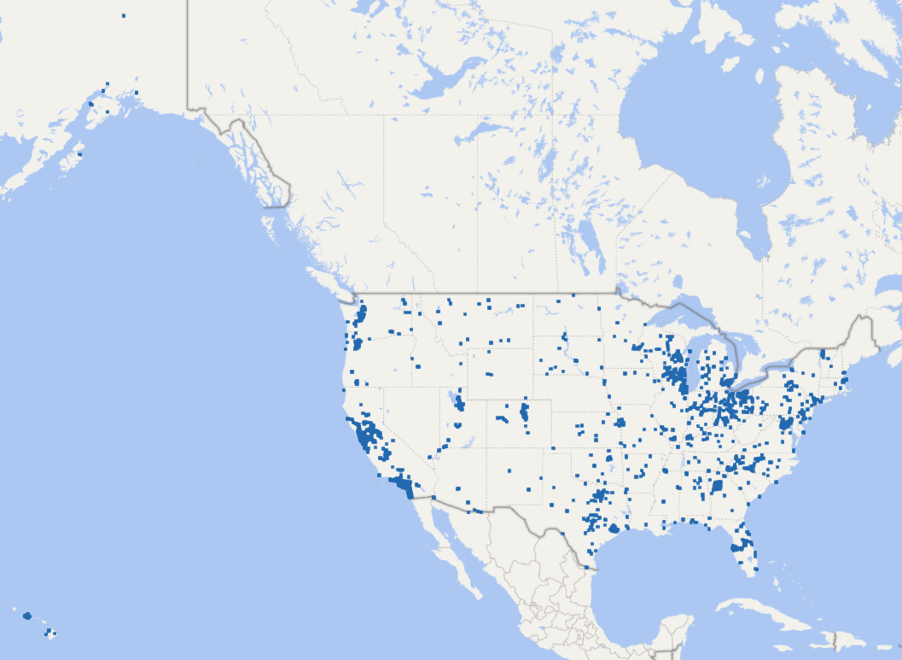
Current Energy to Care Participation
OVER 3,400 Participating Facilities
Notes:
Current participation rate for Energy to Care.

Slide 17
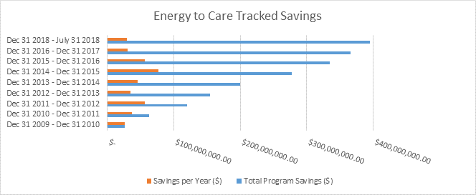
Financial - Total Program Savings
Since 2010, hospitals and health care facilities participating in ASHE's Energy to Care program have put more than $395 million dollars in energy savings back into patient care.
Notes:
The program started in 2010 and since then we have saved $395M. This has allowed members to reallocate the funds to improve patient care.

Slide 18
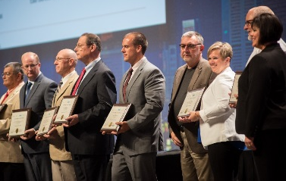
Energy to Care Product Line – Bringing Value
1. Dashboard Tool
2. Education
3. Treasure Hunt Program
4. Awards and Challenges
You Can’t Manage What you Don’t Measure!
Notes:
Brings us to the Energy to Care program.
The goal of EtC is to provide resources that will help FM improve operation of a facility.
4 product lines – each leading to the next
Bench mark – lets them understand what the facility is using. We utilize Energy Star Portfolio manager and provide the participants with a free dashboard tool.
Education – provide resources to encourage action – monographs, tips of the month, success stories
Treasure Hunts – Hands on approach to promote behavior and reinforce change
Awards – recognition for efforts

Slide 19
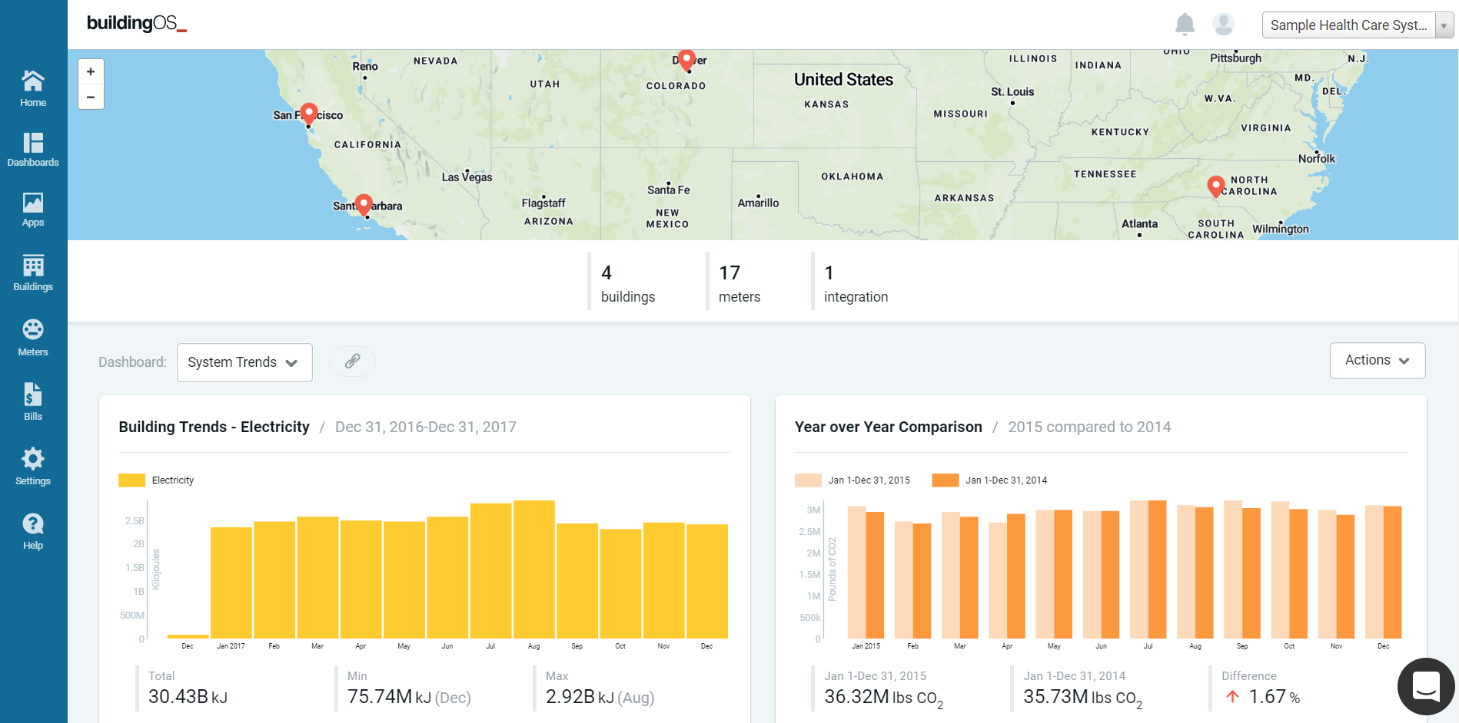
1. Energy to Care Dashboard Tool
FM inputs building and utility data in Energy Star Portfolio Manager
FM Shares Data with ASHE
FM Shares Data with Lucid Building OS
ASHE buildings free dashboard in Building OS
Special thanks to the Energy to Care Diamond Sponsor!
Notes:
Process for enrolling in Energy to Care

Slide 20
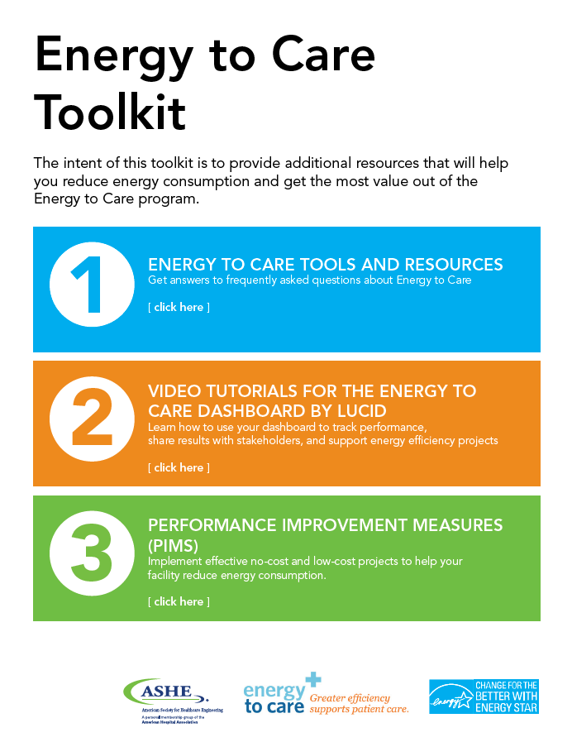
2. Energy to Care – Educational Resources
Notes:
Numerous educational resources available on the Energy to Care and ASHE websites including:
Sustainability Tip of the Month – blog style articles from industry experts on the Energy to Care website
Monographs – including recently published, “Reducing Operational costs Through Energy Efficiency” Includes energy savings project tips for low cost/no cost measures, new construction, energy procurement, renewable energy, etc. Includes case studies from a variety of facility sizes in numerous geographical regions across the US.
Energy to Care Success Stories – More Success stories on the Energy to Care website that feature a variety of facility sizes in numerous geographical regions across the US.
myASHE on-line member community to receive input from peers
Energy to Care Toolkit, including performance improvement measures with a variety of energy efficiency projects.

Slide 21
3. Energy to Care Treasure Hunt
Participants learn to identify low cost/no cost measures for efficiency as well as Capitol Measures.
Treasure Hunts result in a culture change geared toward efficiency.
Engage layers of personnel
Notes:
What is an Energy to Care Treasure Hunt?
The Energy to Care Treasure Hunt is a 1 to 3 day ASHE hosted program event based on the ENERGY STAR Treasure Hunt Program. The program is designed to engage attendees in identifying low-cost energy savings opportunities from behavioral, operational, and maintenance actions. Treasure Hunts provide training, allowing teams to focus on identifying energy efficiency improvements and to develop a philosophy of building an energy culture inside their organizations. Since its rollout, the Energy to Care Treasure Hunt has been a success in helping hospitals become more efficient, thus conserving more resources for patient care. The program has helped some hospitals identify over $200,000 in energy savings! These incredible case studies have solidified that this program is wildly effective for hospitals striving to reduce costs and inspire behavior change for building a culture of efficiency. Energy to Care Treasure Hunts can be conducted as a Chapter Event or by an individual, hospital, system or network. The hope of the program is that attendees will learn how to apply what they’ve learned on the hunt back at their own facilities, inspiring a ripple effect of culture change and resource conservation.

Slide 22
Key Learning Objectives
3. Energy to Care Treasure Hunt
Adopt a culture of continuous improvement to reduce energy consumption and cost
Identify no- and low-cost energy savings opportunities
Engage and train hospital staff from all departments
Create facility action plans
Establish and assign project implementation responsibilities
Notes:
The ASHE Energy Treasure Hunt Program offers several key learning objectives to its participants.
First and foremost, every participant will learn how to adopt a culture of continuous improvement to reduce energy consumption and cost.
Through the survey and checklist process, they will also gain the ability to identify no- and low-cost energy savings opportunities at their own facility as well as engage and train hospital staff from all departments on how to implement their own Treasure Hunt event.
Participants will learn to create facility action plans to promote long-term success and establish and assign project implementation responsibilities for identified projects that result from the Treasure Hunt itself.

Slide 23
4. Energy to Care Awards Program
The Energy to Care Awards honor health care facilities that reduce energy consumption by 10% in a single year or by 15% over two years. The program also recognizes previous award winners that reduce energy consumption by 5%.
The Energy Champion Award is given out once per year to honor a single facility that has demonstrated outstanding leadership in energy efficiency.
Notes:
BENEFITS OF AWARDS PROGRAM:
Who doesn’t like to be recognized for their work?
Your facility will earn national recognition from ASHE for energy savings.
Competitions among ASHE chapters can provide additional rewards.
ASHE Elite Awards are available on an annual basis for your chapter.

Slide 24
ASHE Strategic Plan

Slide 25
Strategic Planning
Update the ASHE 3-year strategic plan
Do we keep or change our strategic imperatives?
Member survey results
What should ASHE set as priorities?

Slide 26
Evolution of the Strategic Imperatives
Succession Planning becomes Professional Development
Focus on education and career advancement
Sustainability becomes Operational Excellence
Creating efficiency, reducing cost and improving performance
Member Value becomes Professional Reputation
Increasing credibility within the industry. Partnering with related organizations.

Slide 27
ASHE Strategic Imperatives
Operational Excellence
Career
Development
Professional Reputation

Slide 28
Influencing Related Organizations
APIC – Association for Professionals in Infection Control
ACHE – American College of Healthcare Executives
AAMI – Association for the Advancement of Medical Instrumentation
ASHHRA – American Society for Healthcare Human Resources Administrators
ASHRM – American Society of Healthcare Risk Managers
United Affiliated Plumbers and Pipefitters

Slide 29
Career Development

Slide 30
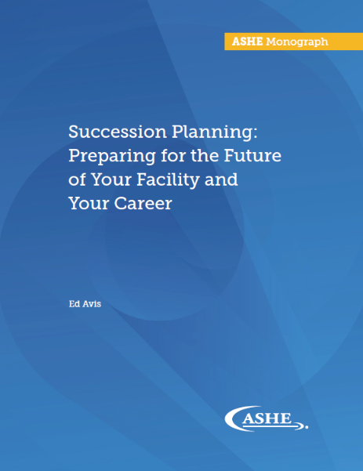
Career Development Resources
Monograph: Succession Planning: Preparing for the Future of Your Facility and Your Career | ashe.org/monographs
Volunteering with My ASHE | my.ashe.org
Video for high school and college students | ashe.org/yourfuture
Notes:
Succession planning is a major concern for many of us. Members preparing for retirement may be concerned about who will take over the reins when they leave. Members looking to advance in their careers may be concerned about their career path and what they need to do to take the next step in their career.
Fortunately ASHE has resources for these concerns. The Succession Planning monographs helps members plan for their own future as well as the future of their facilities. It includes step-by-step instructions on how to create a succession plan and how to create your career path. Be sure to download the monograph, available free for ASHE members.
If you are looking to jumpstart your career, consider volunteering with ASHE. Serving on a task group can be a great way to show your expertise and develop leadership skills that can help you in your career. Volunteer opportunities are available through My ASHE.
Finally, I wanted to showcase a video ASHE developed targeted at young people who may not know our field exists. This is a video that you can use if you ever are speaking at a high school or college job fair—or if you are just trying to explain the field to someone who doesn’t know all the behind-the-scenes work it takes to run a hospital.

Slide 31
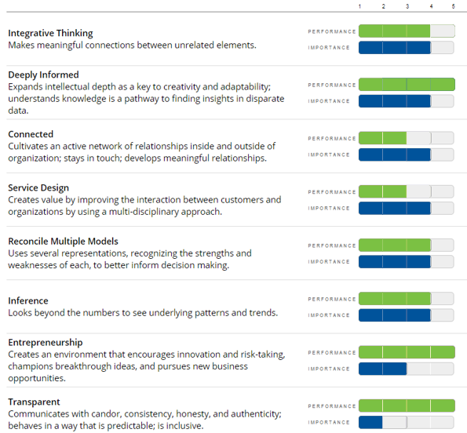
NEW! Career Map Self-Assessment Tool
Allows members to rate themselves on various competencies
Identifies career strengths and weaknesses
Suggests resources/education to improve weak spots
Launched in Fall 2018
ashe.org/careermap
Notes:
This self-assessment tool will allow members to evaluate their current strengths and weaknesses, and receive a customized list of suggested resources and education for career development.

Slide 32
Members-Only Online Community
Launched to all members in December of 2017.
My ASHE: Like the Listserv, only better
Improved features for member-to-member communication
New volunteer platform to promote member engagement
Notes:
MY ASHE is a new online member community to replace the current Listserv. It will help bring networking, collaboration, and resource-sharing to a whole new level.

Slide 33
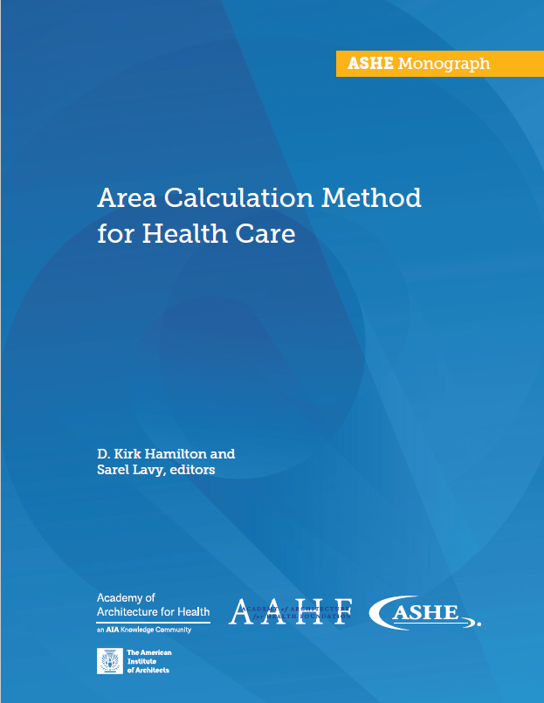
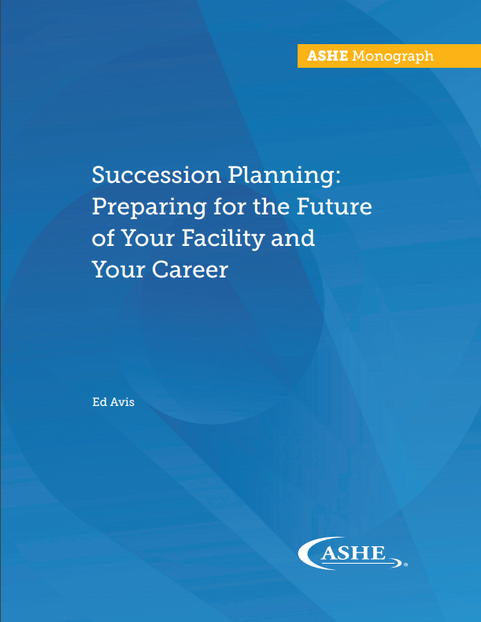
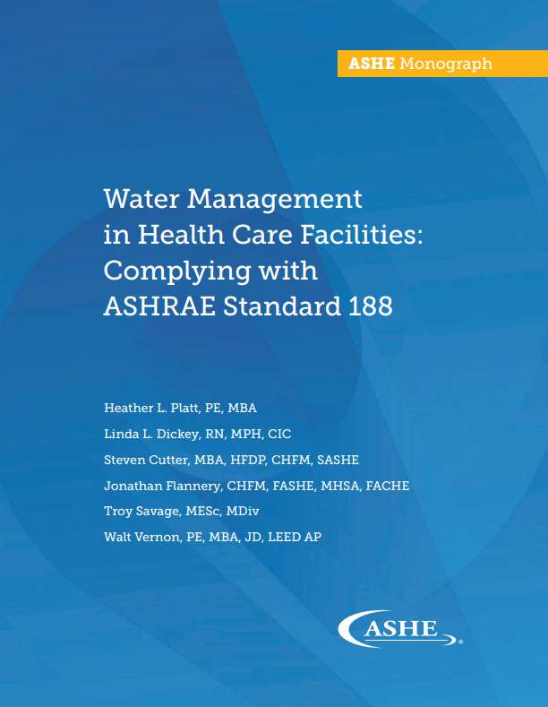
FREE Monograph Downloads
ASHE released 6 new monographs in 2018. Explore and download all available monographs at ashe.org/monographs.

Slide 34
Where can I find additional information?

Slide 35
ASHE Conferences
2019–2020 Conference Dates & Locations:
July 14–17, 2019 | Baltimore, MD
August 2–5, 2020 | Chicago, IL
ashe.org/annual
ashe.org/annual
2019–2020 Conference Dates & Locations:
March 17–20, 2019 | Phoenix, AZ
March 22–25, 2020 | San Antonio, TX
pdcsummit.org
Notes:
ASHE conferences are an excellent way to learn more and to network with colleagues. If you’ve never attended the ASHE Annual Conference or PDC Summit, consider doing so. It is always a great opportunity to recharge your batteries and expand your professional network. Here are the upcoming dates and locations, so be sure to mark your calendars.

Slide 36
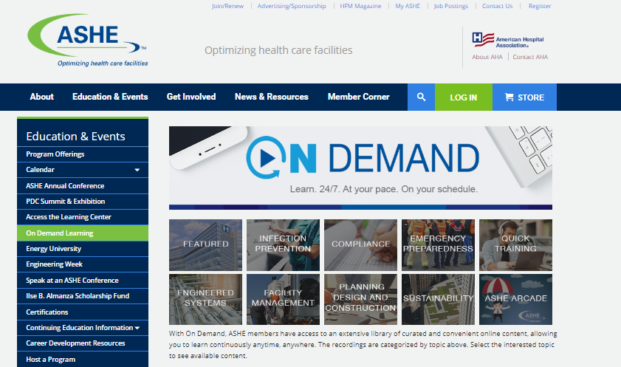
ASHE’s On Demand Library
ashe.org/ondemand
NEW web page layout launched in Summer 2018!
Notes:
Another key resources is ASHE’s On Demand learning library. This web page includes recorded conferences and webinars from previous years. It’s a great way to find information on a variety of topics.

Slide 37
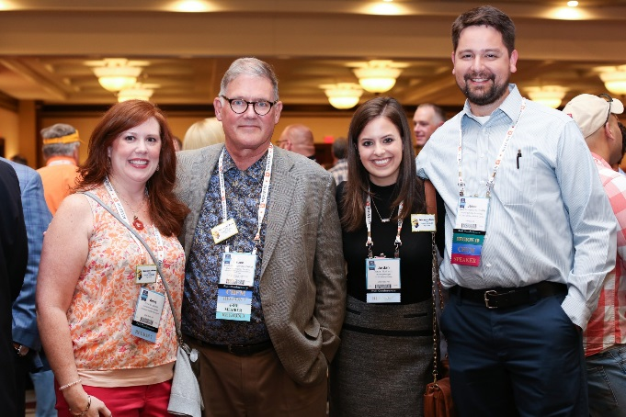
Get involved with ASHE
If you are not an member, join!
If you are a member, get involved!
Participate in My ASHE
Attend conferences
Volunteer
ashe.org
ashe.org
Notes:
To wrap up, I would like to encourage you to get involved and stay involved with ASHE and your local chapter. If you’re not already an ASHE member, join. If you’re already a member, take the next step and participate in the My ASHE online community, attend a conference, or volunteer for a project. Explore the resources that ASHE has available, and feel free to contact me if you have any questions about ASHE offerings. Thank you!

Slide 38
Questions?

